Slide 1
Hate speech Detection
By: Rudraksh Agarwal

Slide 2
INDEx
What do you mean by Hate speech Detection ?
Key components of hate speech detection
Libraries used
Dataset
Train test split
Naive bayes classifier
Classification report & accuracy
Test vs Prediction plot
Input/output

Slide 3
What do you mean by Hate speech DETECTION?
Hate speech detection refers to the use of technology, algorithms, and artificial intelligence (AI) tools to identify and flag content that contains hate speech. Hate speech is characterized by language, expressions, or communication that promotes violence, discrimination, or prejudice against individuals or groups based on attributes such as race, ethnicity, religion, gender, sexual orientation, disability, or other protected characteristics.
The process of hate speech detection involves analyzing text, audio, or visual content to identify patterns, keywords, or linguistic cues associated with hate speech. This is often done through machine learning models that are trained on large datasets containing examples of both hate speech and non-hateful content. These models learn to recognize contextual nuances and linguistic features that distinguish hate speech from other forms of expression.

Slide 4
Key components of hate speech detection
Natural Language Processing (NLP): Analyzing and understanding the meaning of text to identify potentially harmful language.
Machine Learning Models: Training algorithms on labeled datasets to recognize patterns and characteristics of hate speech.
Pattern Recognition: Identifying recurring patterns or keywords associated with hate speech to create effective detection rules.
Contextual Understanding: Considering the context in which certain words or phrases are used to avoid false positives and accurately detect hate speech.
Multimodal Detection: Extending detection to audio and visual content, in addition to text, for a more comprehensive approach.
User Behavior Analysis: Monitoring user behavior to identify patterns of engagement with or propagation of hate speech.

Slide 5
Libraries used
Pandas
Scikit learn
Naive Bayes
Matplotlib

Slide 6
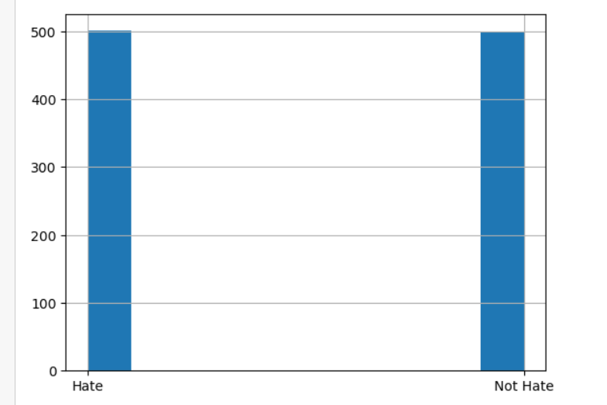
Dataset
The Dataset I have considered has equal number of hate and not hate cases. Which is being checked by a presenting a histogram.

Slide 7
Train test split
Now, we have make a split operation using the train_test_split module of sklearn library.
And make a 70:30 split in the data set i.e. 70% training set and 30% test set.

Slide 8
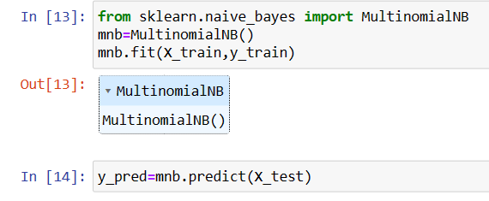
Naive bayes classifier
Here, we have used the Multinomial Naïve Bayes Classifier which is one of the most popular Machine Learning Algorithm for Hate Speech Detection(Text Classification).
Using which we have trained our model on the training data and tested it on test data.

Slide 9
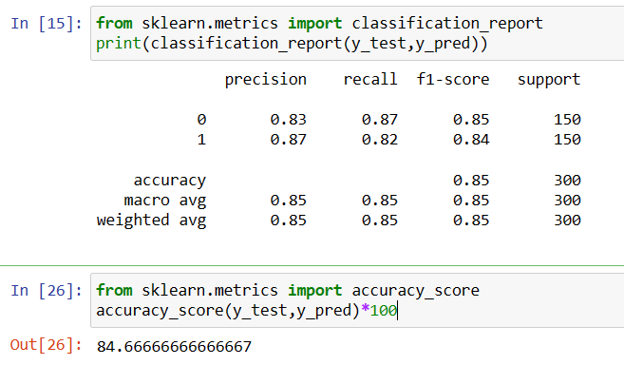
Classification report & accuracy
We have calculated the precision, recall, F1 score, support.
We have also calculated the accuracy_score.

Slide 10
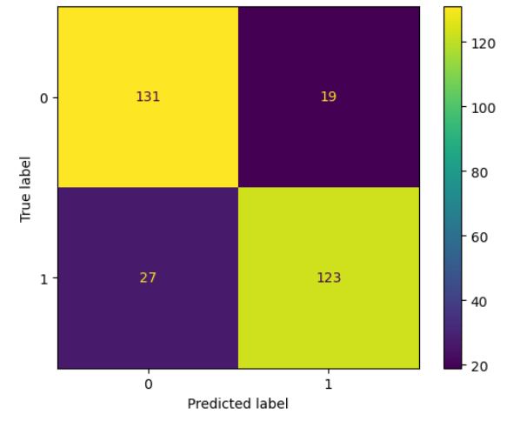
Test vs Prediction plot
Here we have used concepts of confusion matrix and display it using confusion matrix display.
Also plotted it using the matplotlib library.

Slide 11

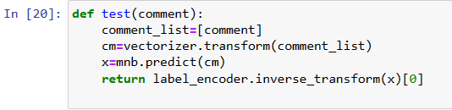

Input/output
At the End of the Code, we have placed a user defined function namely test which takes comment as input and gives suitable output.
Hate :
Not Hate:

Slide 12
THANK YOU
Rudraksh Agarwal

